Slide 1
DevOps 101
Application Economy
Digital Transformation
DevOps History
What is DevOps Defined
Software Development Life Cycle (SDLC)
How Verizon lights up the Application Factory
Application Economy
Software Development Life Cycle (SDLC)
DevOps History
What is DevOps Defined
A Call to Arms

Slide 2
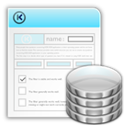


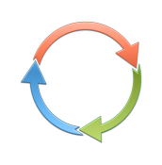





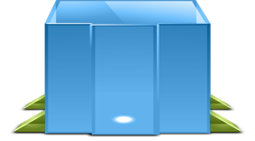
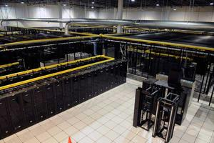
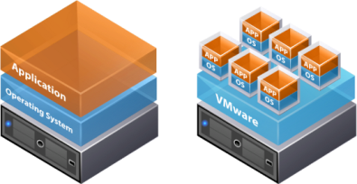
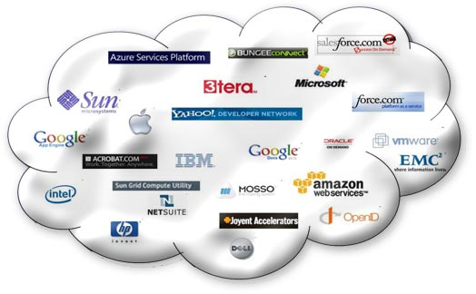
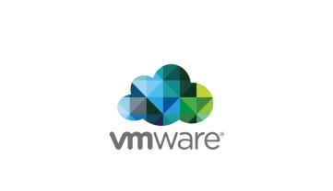

Verizon lights up the Application Factory
Connectivity
Security
Managed Services
Optimization
Continual Improvement
application
DAYS/MINUTES
Application Delivery
Operations guys
Better Customer
Experience
Developers
Business Value
Innovation
DEV
INT
UAT
PERF
PROD
Hybrid-IT

Slide 3


$177B
“Software is eating the world”
Public cloud services market expected to grow 16% in 2015 to $177 billion¹
- Marc Andreeson
Wall Street Journal, Why Software is Eating the World, August 2011
Application Economy
268B
welcome
to the
By 2017, mobile apps will be downloaded more than 268 billion times²
50%
By 2018, more than 50% of B2B collaboration will take place through Web APIs³
¹ Gartner Forecast: Public Cloud Services, Worldwide, 2012-2018, 4Q14 Update, Ed Anderson, et al, 10 April 2015
² Gartner Hype Cycle for Application Development, 2014, Thomas E. Murphy, et al, 29 July 2014
³ Gartner Press Release, “Gartner Says by 2017, Mobile Users Will Provide Personalized Data Streams to More Than 100 Apps and Services Every Day” January 22, 2014 http://www.gartner.com/newsroom/id/2654115
¹ Gartner Forecast: Public Cloud Services, Worldwide, 2012-2018, 3Q14 Update, Ed Anderson, et al, 29 September 2014
² Gartner Hype Cycle for Application Development, 2014, Thomas E. Murphy, et al, 29 July 2014
³ Gartner Press Release, “Gartner Says by 2017, Mobile Users Will Provide Personalized Data Streams to More Than 100 Apps and Services Every Day” January 22, 2014 http://www.gartner.com/newsroom/id/2654115
Notes:
All organizations are thinking and becoming more like “tech” companies and digital business capabilities are beginning to dominate every industry. As a result, everything is moving more quickly as companies try to achieve first-mover advantage or become fast followers.
Every company in order to survive and grow will need to become a technology company.
Every business will need to become a digital business.
In today’s application economy, every business is a digital business – whether that’s retail, media and entertainment, finance and banking, communications or healthcare – literally everything is driven by an always connected, mobile, application-based world, where consumers are far more likely to experience your brand and engage with your enterprise through a software application than a person. And of course it’s also happening in the public sector, where government agencies are building citizen-centric applications and services….
So welcome to the Application Economy
<<Click>> In 2011, leading venture capitalist and co-founder of Netscape, Marc Andreessen wrote a seminal paper for the Wall Street Journal. Titled “Software is Eating the World”, Andreessen argued that more and more major businesses and industries are being run on software and delivered as online services—from movies to agriculture to national defense.
He argued that with lower start-up costs and a vastly expanded market for online services, we’ve arrived at a global economy that for the first time will be fully digitally wired— the Application Economy
….he wasn’t wrong
So what’s driving this new world – what can make every business, even yours – a software business <<Click>>
Well, firstly the cloud of course which has lowered the cost of entry. Fifteen years ago the cost of running a basic internet based software application was more than $100,000 a month, now with the cloud, I can run same application for less than $500 – and what’s more I only pay or what I use. Little wonder that spending on public cloud services exceeded $177B billion worldwide in 2015
What’s also exciting is how APIs have become a primary customer interface for technology-driven products and services and a key channel for driving revenue and brand engagement. Many leading companies have recognized this of course, like for example saleforce.com who generates half of its revenue through API’s and not traditional user interfaces – they’re not alone – Twitter processes 15 billion transactions every day through API’s and Amazon close to a trillion. Perhaps no surprise then that by 2016 analysts predicts that half of B2B collaboration will be driven by through API’s
Add to this, the estimated 268 billion mobile apps that will be downloaded by 2017 ( and we have a perfect storm – low cost cloud services and extreme mobility – where every individual with smart phone can access the full power of the Internet and potentially engage with your brand, every moment of every day.
To thrive in this new reality, developing and delivering applications that drive superior user experiences and engage your customers and staff is the new business imperative.

Slide 4


Speed and agility are critical, but resilience is even more important…
UNPRECEDENTED SPEED
RESILIENCE
94%
of executives face increased pressure to release apps more quickly
25%
of users will abandon a web application after just three seconds of delay

Slide 5
Expectations Are Changing
UNPRECEDENTED SPEED
EXCEPTIONAL CUSTOMER EXPERIENCE
94%
25%
of executives face increased pressure to release apps more quickly
of users will abandon a web application after just three seconds of delay
2015 Vanson Bourne study commissioned by CA
Source: Reaching the Top of the Web Performance Mountain
Notes:
The application economy means new and unprecedented demands for IT organizations and expectations continue to grow. Living up to these expectations is a tremendous struggle for many, and may require updating, revising or replacing infrastructure, app design, service delivery, IT skills, technology assets or even business models.
Customers expect to connect with companies via software for fast easy access to products, services, and information.
If your company isn’t meeting these expectations, your customers are likely to go elsewhere.
In the application economy, external, revenue-generating customers are the most influential stakeholders.

Slide 6
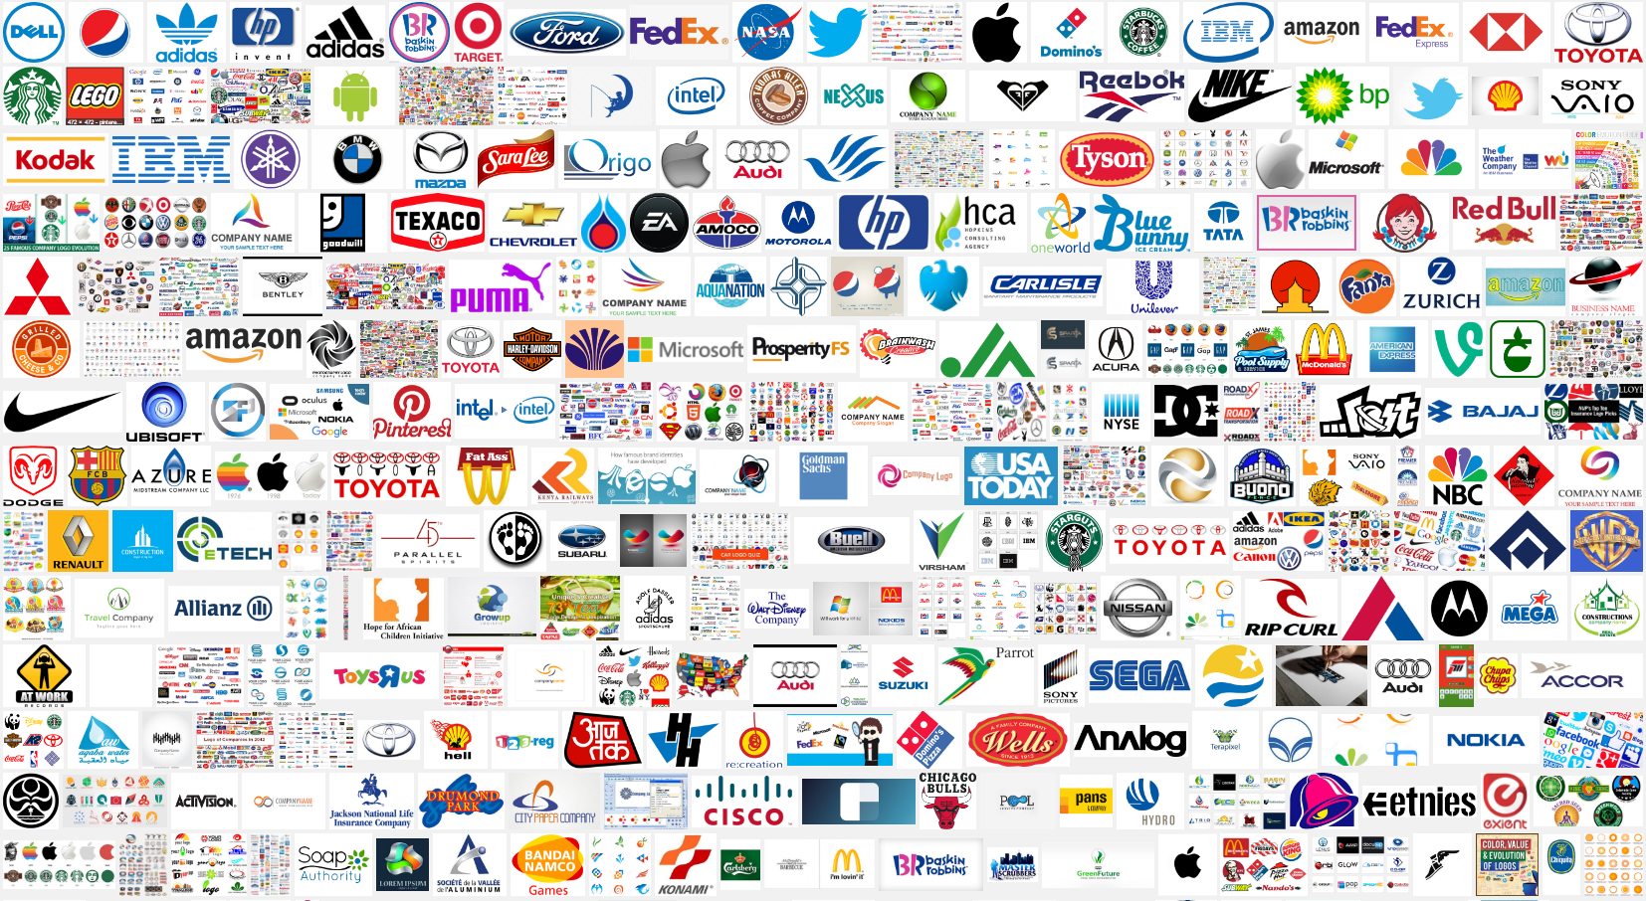
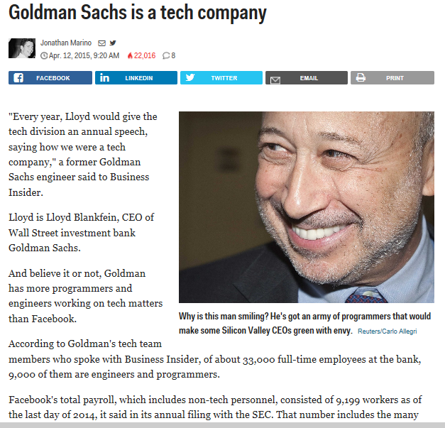

Slide 7
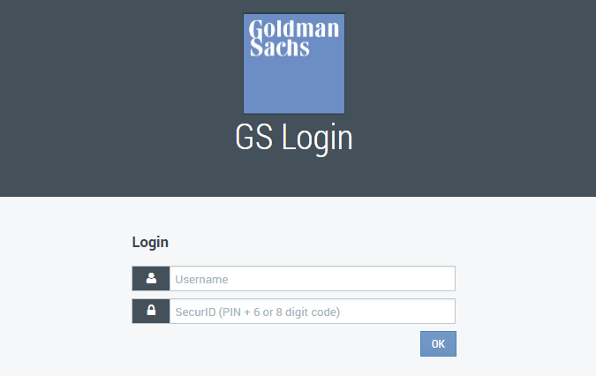
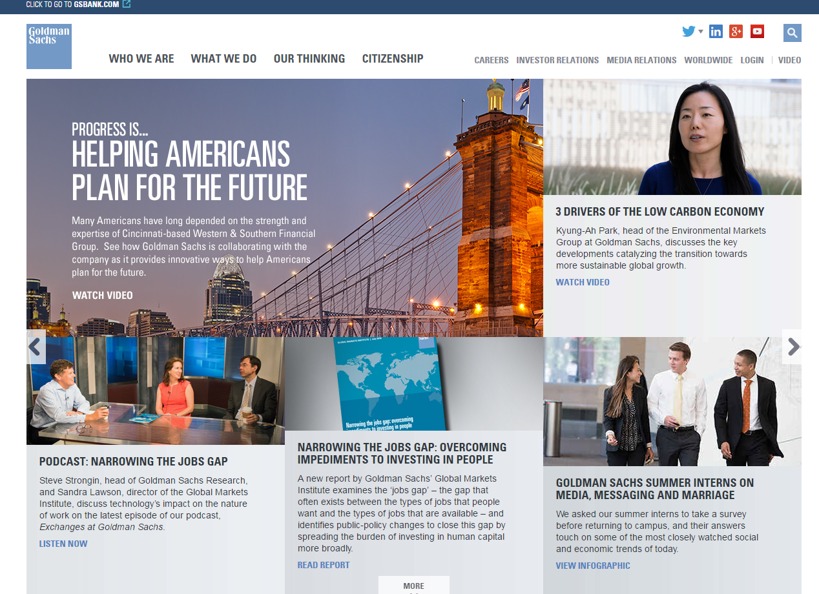

Slide 8


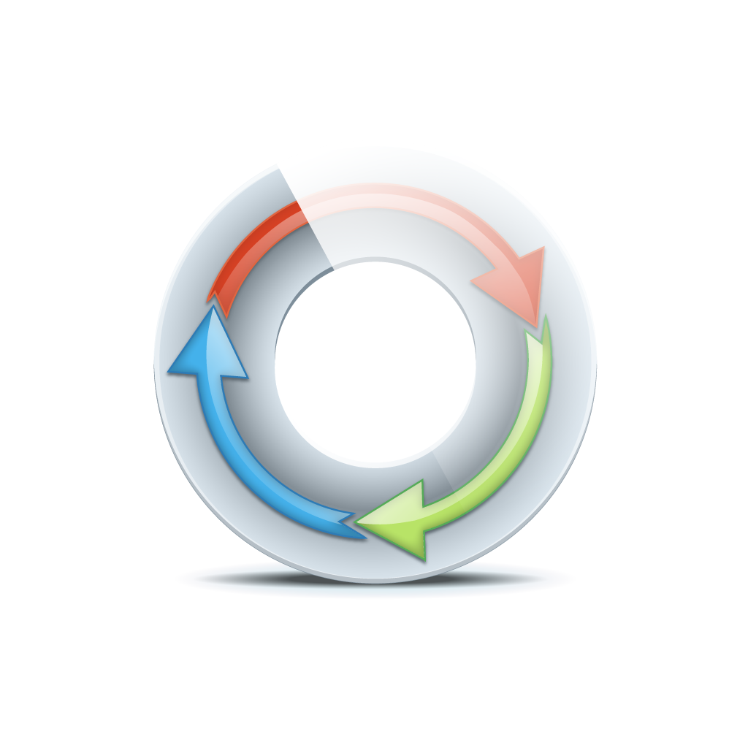


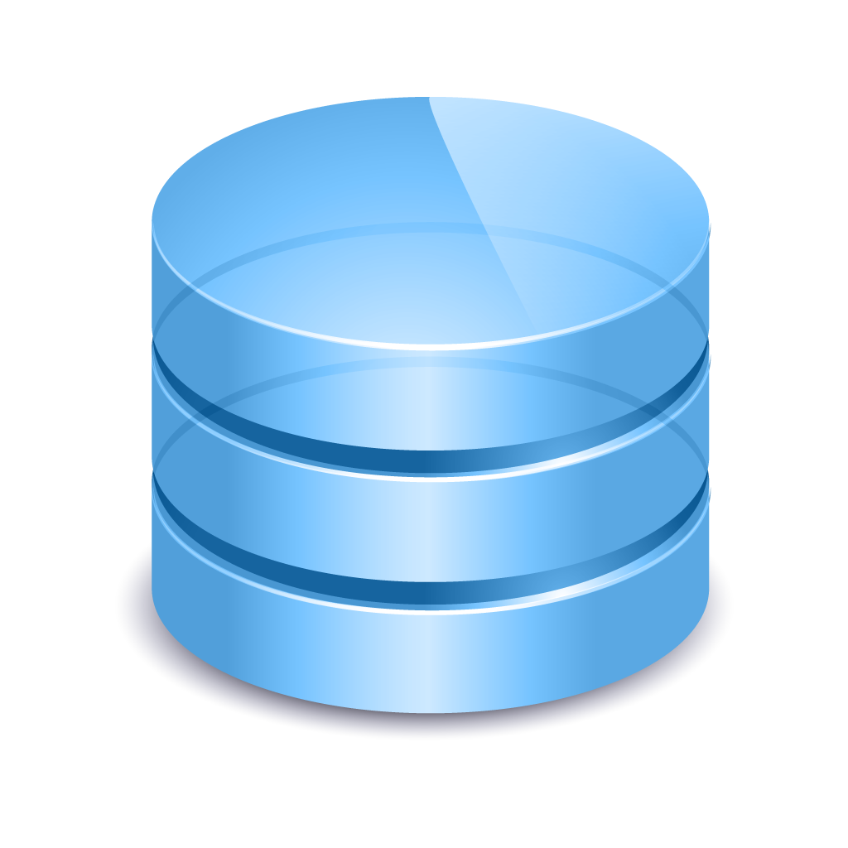
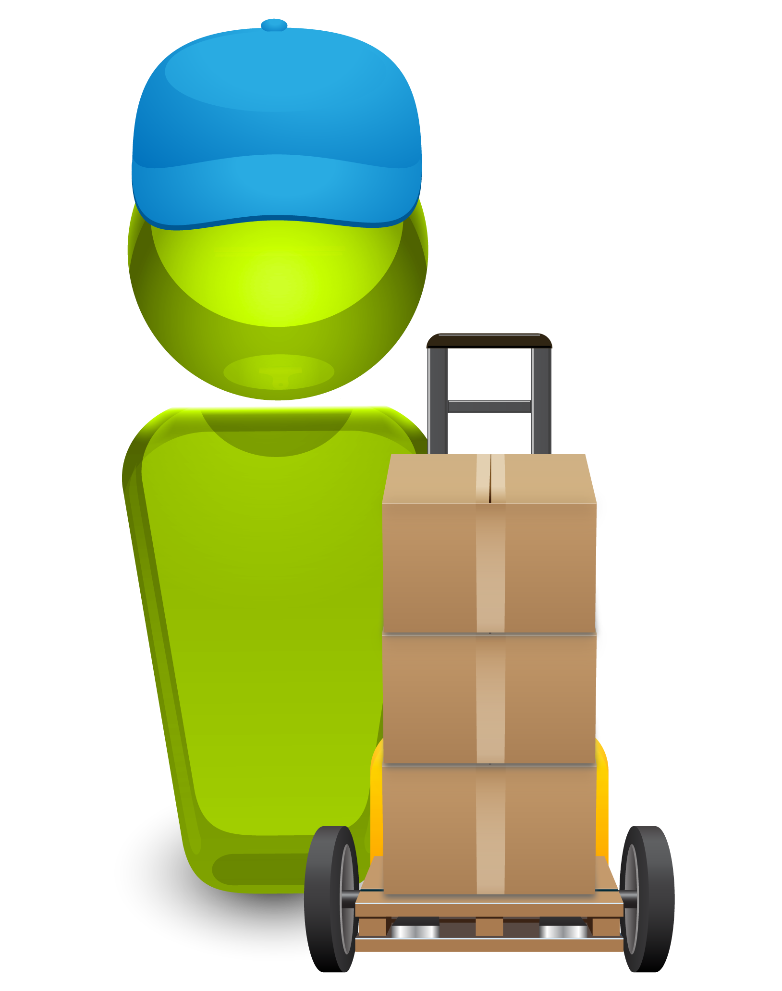
Building a Better Brand
DELIVERED RAPIDLY
HIGH- QUALITY
REPEATABLE
Innovation
Better
Customer
Experience
CONTINUOUS
DELIVERY
Developers
DEV
INT
UAT
PERF
PROD

Slide 9
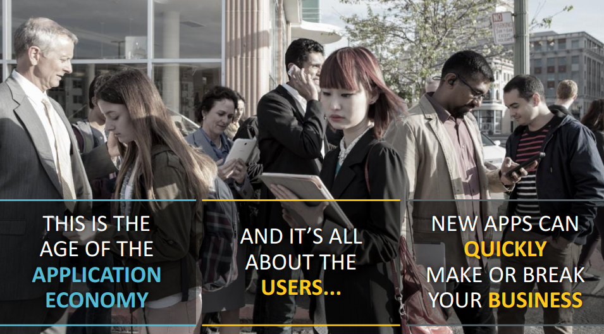
Building a Better Brand

Slide 10



DevOps is not just about Increasing # of Releases It is about Accelerating Throughput… Speed with Quality!
ACCELERATE DELIVERY
New applications
Changes to existing apps
Bug fixes
INCREASE RELIABILITY
Software is the customer experience
Quality and Performance are critical
MANAGE COMPLEXITY
Composite services and heterogeneous systems
Reduced budgets
Distributed development teams and IT partners

Slide 11



Slide 12
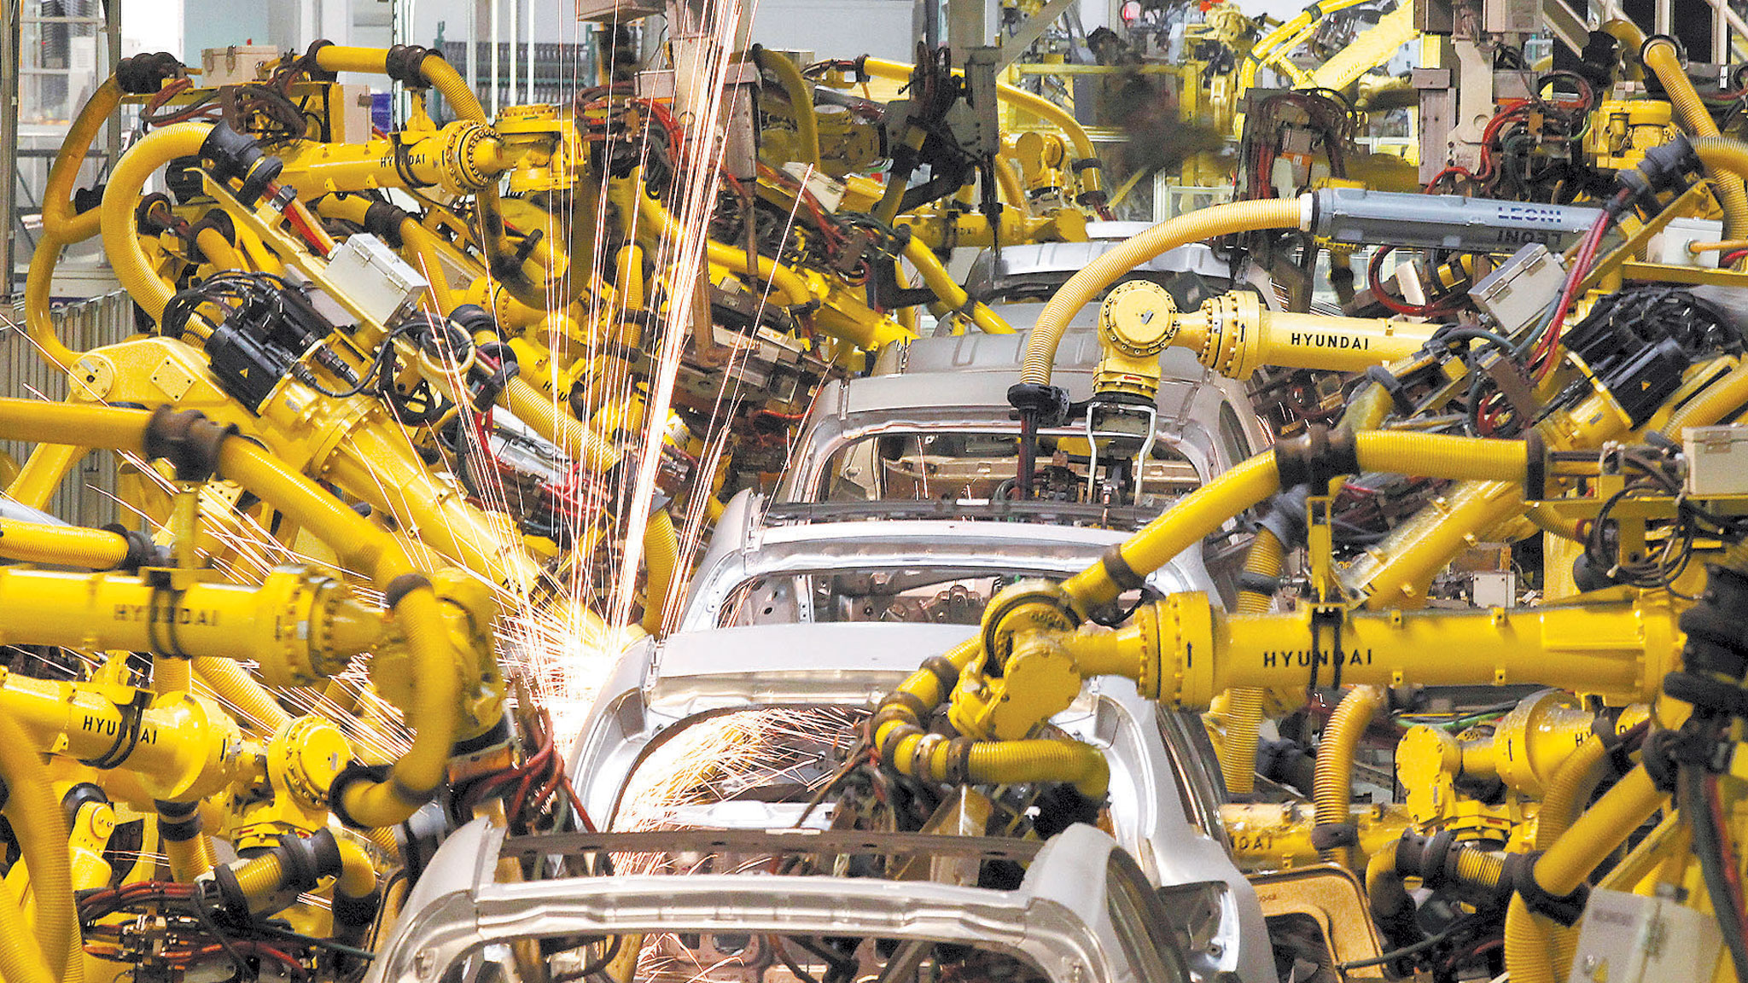
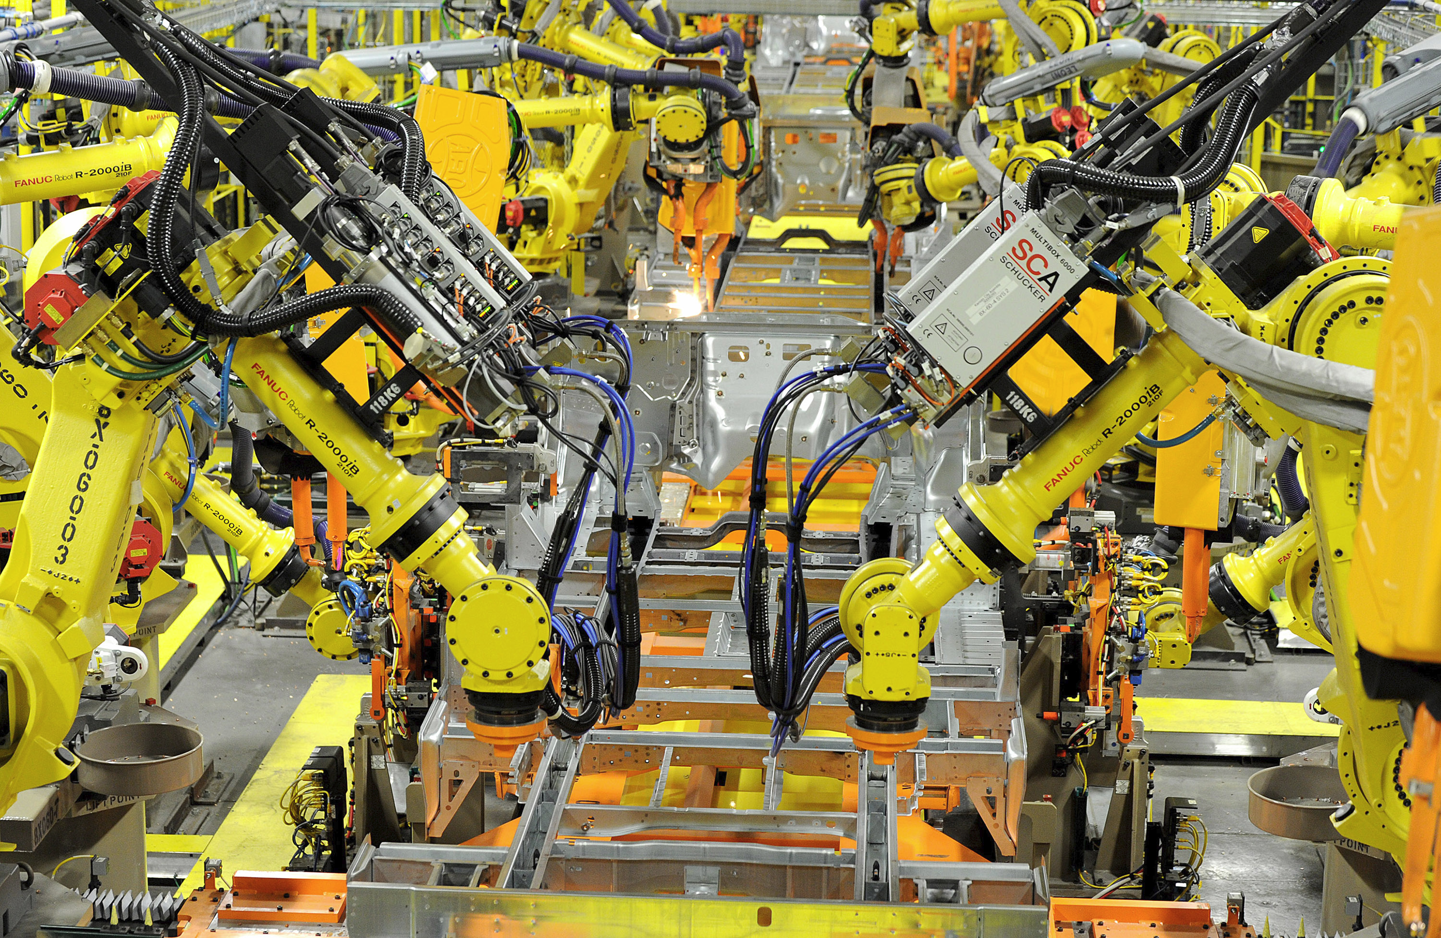
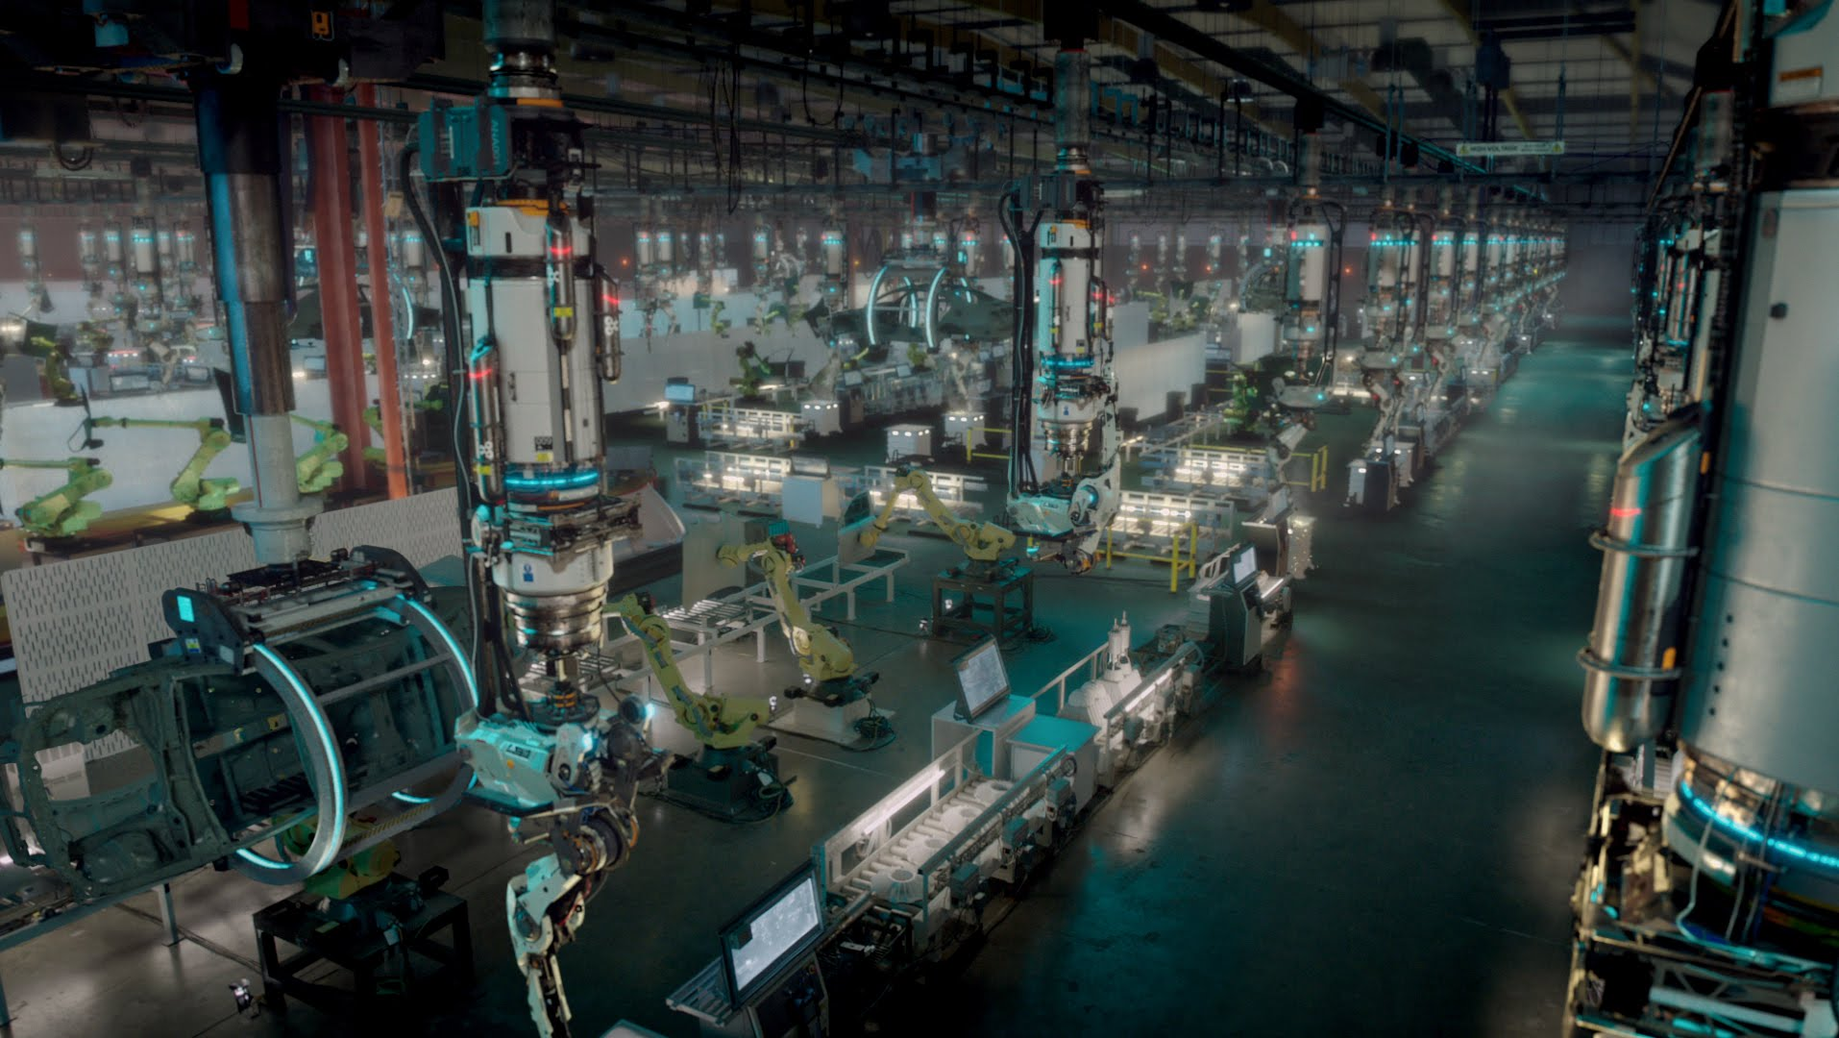

Slide 13


Slide 14


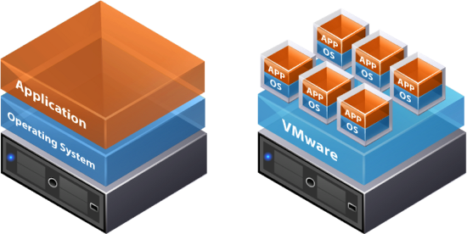
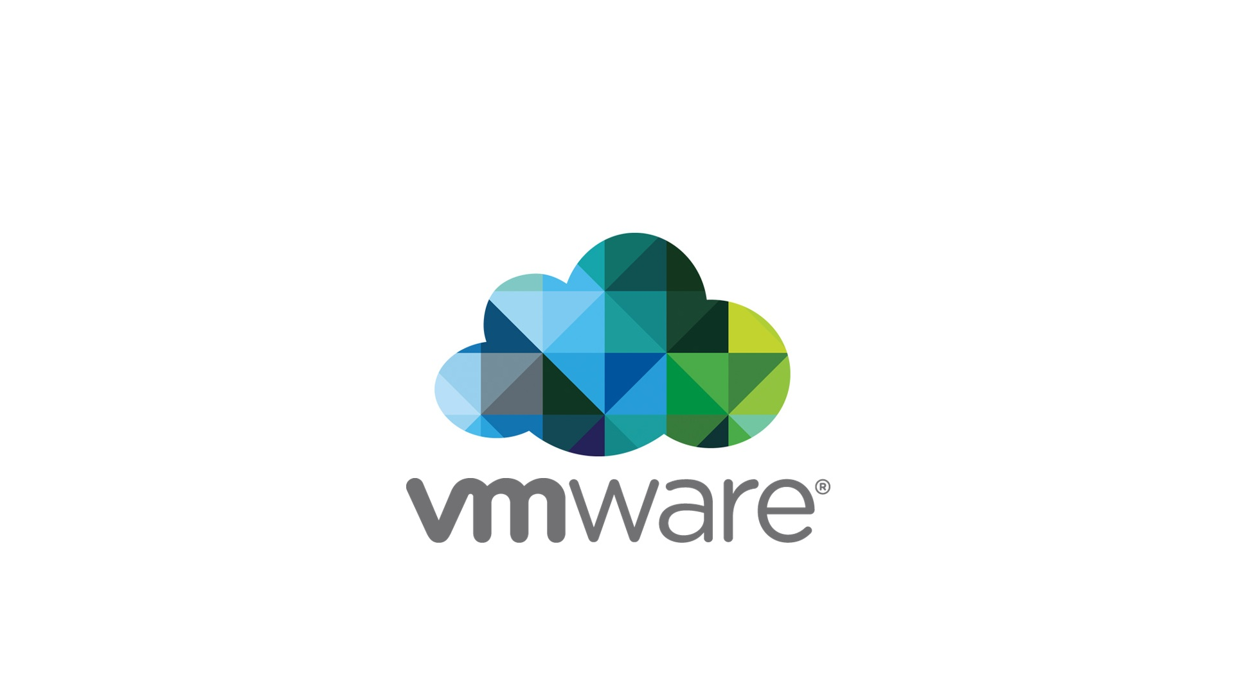

Patrick Debios
The Promise of the digital world
Compliance Rules, Transparency, Regulations, Policies, LAW, Standards, Requirements
Security
Data Management/
Assurance
application
Network
DAYS/MINUTES
Application Delivery
Operations guys
Customer
Experience
Developers
Business Value
Innovation
DEV
INT
UAT
PERF
PROD
Hybrid-IT

Slide 15
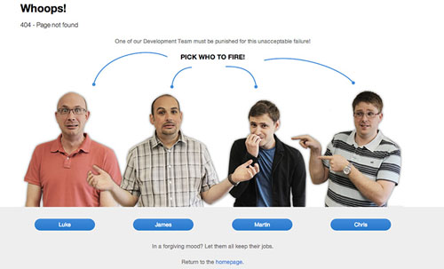

Slide 16




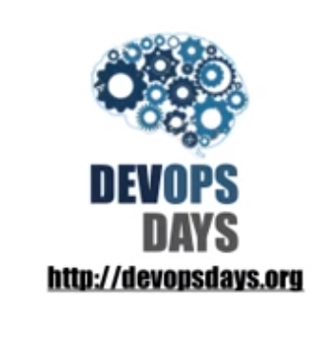

Slide 17










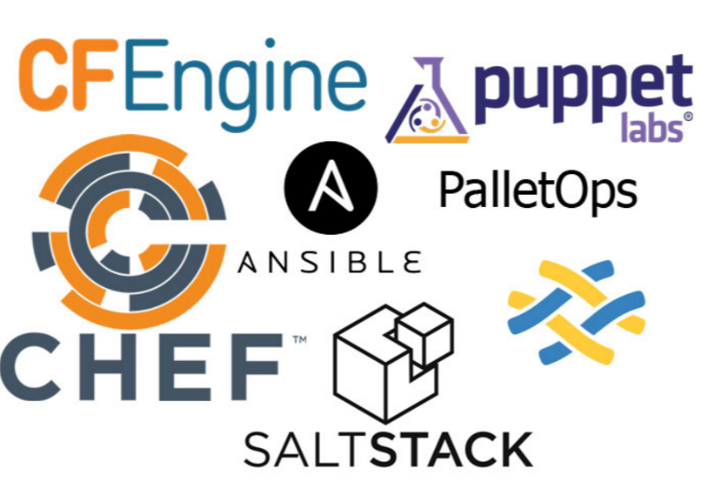
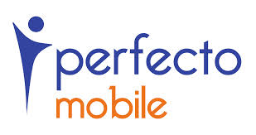
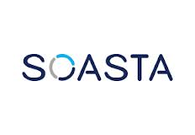

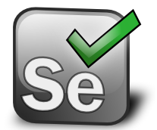

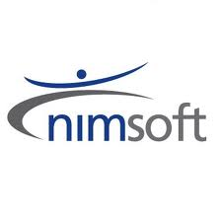
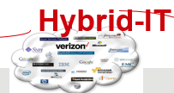


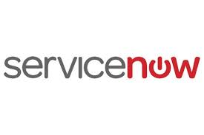
DevOps Tools
API
API
ARTIFACT REPOSITORY
CONTINUOUS INTEGRATION
BUILD AUTOMATION
API
TEST AUTOMATION
CONFIGURATION MANAGEMENT
API
API
Environment Data
ITIL
Application Model
CHANGE MANAGEMENT
INFRA PROVISIONING
SDLC
Release Data
INT
UAT
PERF
PROD
VERIZON BACKBONE - API

Slide 18
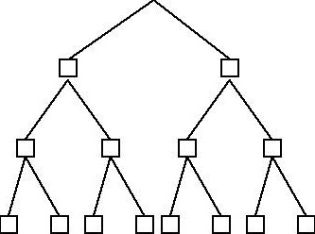
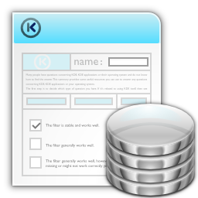
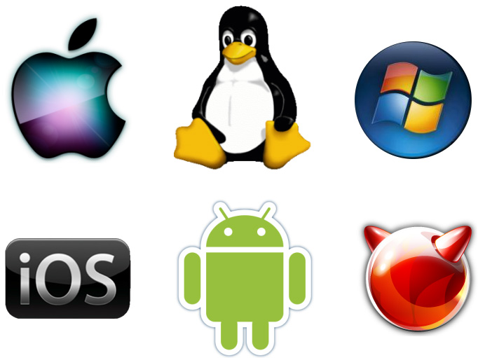

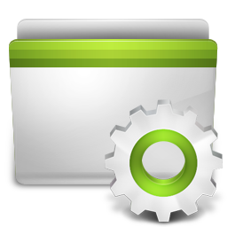
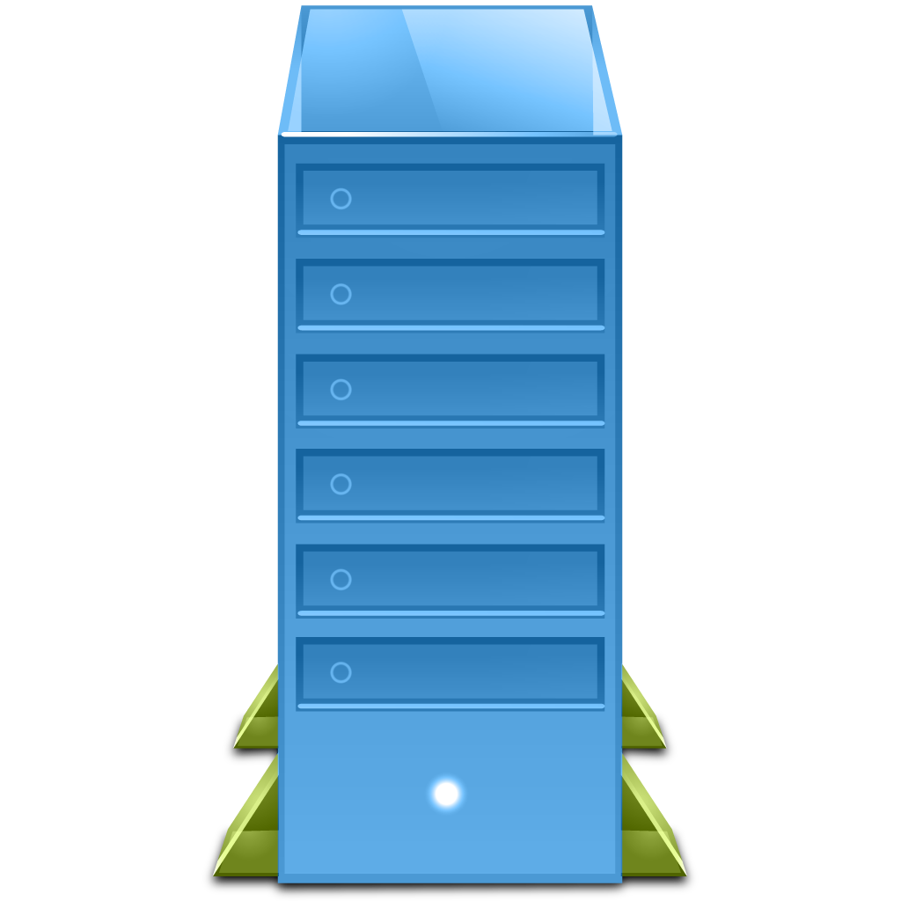
Application Delivery – A Day In The Life
application
LB
Authentication
Portal
AppServ
WebServ
DB
Engines
SECURITY
NETWORK
DATA MANAMGEMENT
artifact
Supplier 1
test
acceptance
production
Supplier 2
Supplier 3
Hybrid-IT

Slide 19



Developers Deadlocked
Constrained Environments
Manual
Testing
Too little testing, too late in the cycle
Too many disparate tools
Manual
Scripting
Poor customer experience
Customer
Experience
Work Time
Wait Time
IDLE TIME
IDE
SCM
DELAYS
TEST
DELAYS
DELAYS
CI
CONTAINER
CONFIG
CLOUD
PROVISION
Code | Integrate | Build
defect
Functional & UA Testing
defect
Performance Testing
defect
Deploy to Production
DEV
QA/TEST
PRE-PROD
PRODUCTION
RE-WORK
RE-WORK
RE-WORK
SLOW AND INEFFICIENT - EXCESSIVE IDLE TIME, DELAYS AND RE-WORK

Slide 20

What are Challenges that Companies are Experiencing?
DEVELOPMENT
OPERATIONS
SPEED
STABILITY
Customer
Experience
Agile, Lean
ITIL, process, SLA’s
Bring features/products to market faster
Ensure availability; MTBF
Cloud, open source, infrastructure-as-code
Keeping the promise of the digital world

Slide 21
DevOps Transforms People, Process AND Technology
DEVELOPMENT
OPERATIONS
SPEED & STABILITY
Customer
Experience
Communication and shared metrics and goals - driving business value
Collaboration and Continuous Feedback
Technology toolset enabling DevOps

Slide 22
How long does it take to release an application?
What are the most challenging aspects of your application deployment process today?
Please describe your overall change and release processes.
What strategic initiatives are driving the demand for increased business and operational agility?
What are your current release times or frequency of development/test/stage/production deployments?
How do you run your application deployments today? How much of that are manual or scripts based?

Slide 23
Customer Champions & Stakeholders
VP DEVELOPMENT/ APPS AND ENTERPRISE ARCHITECTS
VP OPERATIONS, DEVOPS/RELEASE MANAGER
LINE OF BUSINESS OWNER (LBO)
Driven by meeting/exceeding project goals; faster time to market; meeting/exceeding quality metrics
Driven by meeting/exceeding deployment goals; increasing productivity; improving operational efficiencies
Driven by accelerating time to market; meeting business/financial metrics; reducing risk & cost; business enablement

Slide 24

Better Experience
Verizon helps organizations orchestrate the entire application release process and automate the deployment of applications from development into production.
Application deployment tasks are automated, errors are reduced, software releases are more reliable, and throughput is dramatically improved.
Verizon delivers the promise of the digital world.

Slide 25


Slide 26
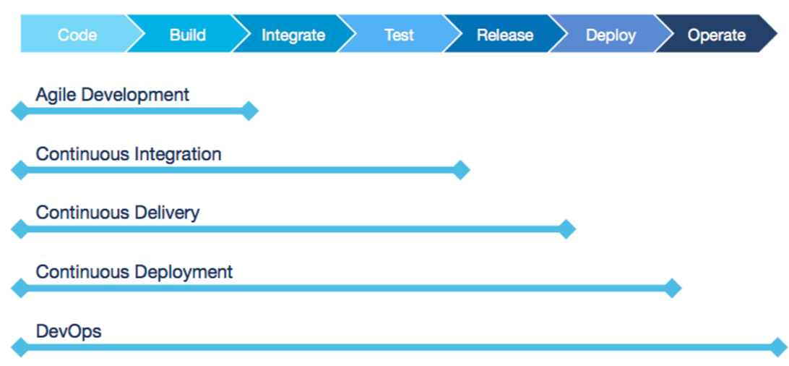

Slide 27

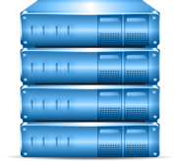



The Challenge of Today’s Complex and Dynamic IT Environment
LACK OF API TESTING (too many bugs escape downstream)
LACK OF AUTOMATED TESTING (small changes could have major unintended consequences)
LACK OF VISIBILITY INTO PROD. APPS (no visibility into the customer experience)
Code
Commit
Developer 1
Developer
Branch SCM
Operations
Code
Commit
CI Server
deploy
deploy
deploy
deploy
Developer 2
Developer
Branch SCM
Integration Lab
UAT/Staging
Environment
Production
Performance Lab
Code
Commit
LACK OF RELEASE AND ENVIRONMENT AUTOMATION (manual processes lead to poor release quality)
Developer n
Developer
Branch SCM
CI Server
Notes:
Put gear on each place we’re doing promotions

Slide 28
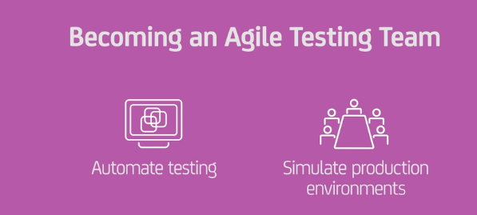
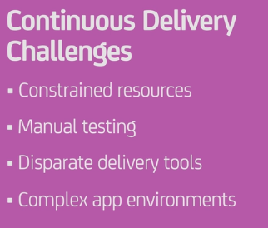
THE PROBLEM DevOps -Automating the Software Development Life Cycle (SDLC)
CONTINUOUS VALIDATION
Code
Commit
Developer 1
Developer
Branch SCM
Code
Commit
CI Server
deploy
deploy
deploy
deploy
Developer 2
Developer
Branch SCM
Integration Lab
UAT/Staging
Environment
Production
Operations
Performance Lab
Code
Commit
DATA
MINING
CONTINUOUS DELIVERY
Developer n
Developer
Branch SCM
CI Server
TRUE AGILE DEVELOPMENT
Notes:
Disparate environments
Test data not equal to production data
Custom Manual testing scripts

Slide 29










So , What is DevOps ?
Continuous Delivery
Culture
Technology
Tools
Process
Customer
Experience
Application Pipeline
Parallel
Work
Streams
Quality
Acceleration
End-to-end Automation

Slide 30
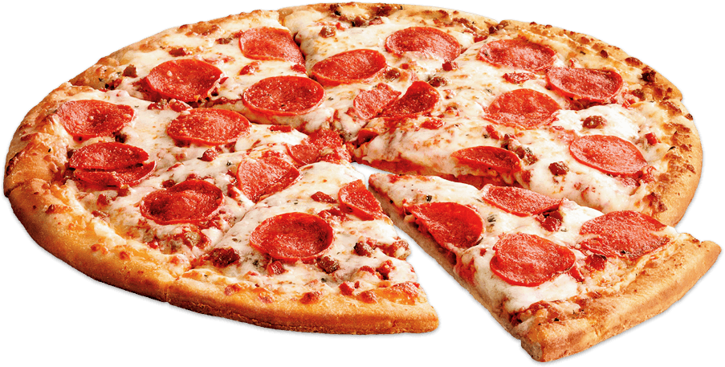



Culture
Development Team
Operations Team
Communicate
Collaborate
Integrate
Understand

Slide 31
Open Communication
Collaborative Workflows
Information Sharing
Respect
Characteristics of a
DevOps Culture
Trust
Operations trust development
Development trust operations
Everyone trust QA
Alignment
Establish shared goals
Foster collaboration

Slide 32
Gain executive sponsorship
Steps to
creating a
DevOps Culture
Assess the cultural landscape
Demonstrate
why you’re changing

Slide 33
WHO
Roles
&
Permissions
Understand the PROCESSES
WHAT
Artifact Management, tracking tracing
HOW
Process
&
Scripts
WHERE
Environments
&
Server Mgmt
WHEN
Scheduling
&
Integration

Slide 34

Processes
CONTINUOUS DELIVERY
Bring Software to market continuously..
Eliminate friction points
Align to business Objectives
ENVIRONMENTS DATA
APPLICATION MODEL
RELEASE DATA
SDLC
Manifest
Manifest
Manifest
Manifest
QA
UAT
PERF
PROD
PROMOTE
PROMOTE
PROMOTE
Notes:
Release data: artifacts for release, release type (full, partial, hot fix), rollback logic, application config
Show same set of environments as other slides

Slide 35

https://www.youtube.com/watch?v=fGaVFRzTTP4

Slide 36
MONTHS
Software Development Life Cycle
DEV
PROD
DEV
QA
UAT
PERF
PROD
Innovation
PROD
Business Value

Slide 37


Identifying the problem
MORE INNOVATION, QUICKER, LESS COST
Agile Development
Test Automation
Continuous Integration
Long Time To Market
Virtualization/Cloud
Provisioning Automation
Configuration Mgmt
50%
Release Errors
High Costs
Innovation
DEV
INT
UAT
PERF
PROD
Business Value
MONTHS
DAYS/MINUTES
CONTINUOUS DELIVERY
Notes:
Use previous environment pics…redo
This slide discusses the state of many development and IT operations organizations today.
We start off talking about Innovation. A lot of innovation is happening on the development side. Development can create new applications and features faster than organizations can get them to production where they create real business value.
Many development teams have implemented Agile methodologies, automated testing and Continuous Integrations systems to help speed up development and unit test cycels and reduce bottlenecks on the dev side.
It Ops have implemented virtualization, cloud and infrastructure and configuration automation technologies to help speed up the provisioning of infrastructure components.
According to Gartner more than 80% of all mission-critical IT service outages result from people and process errors and failures, and of those outages, more than 50% result from a lack of coordination between change, release and configuration management processes.
All which result in delayed time-to-more and increased costs.
A Continuous Delivery solution that automates the release and deployment processes and eliminate in-house written scripts and manual processes can significantly improve the speed and quality in which applications are delivered across the entire application lifecycle – development through production.

Slide 38







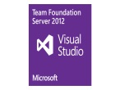


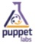





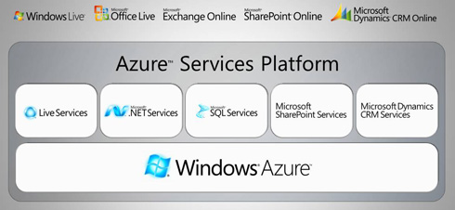


Technology Tools
Document requirements
Design Spec
Customer
Experience
Plan Release
REP MGR
SCM
CI
CONTAINER
TEST
CONFIG
CLOUD
PROVISION
Code commit
SCM
CI/Build
Integration testing
Functional testing
UAT
Deploy to pre-prod
Performance testing
Deploy to production
DEV
QA/Test
PRE-PROD
release alert & details
PRODUCTION
APM

Slide 39

DevOps Practice
WE WANT YOU ! | Help Sales deliver a unified DevOps Conversation. Map the DevOps conversation to Verizon’s Solutions.
Become DevOps SME Gain Hands-On Experience with DevOps tools Communicate, Collaborate and Integrate with Developers Team up with a partner to help build out the Application Factory. | BUILD OUT AN APPLICATION FACTORY Integrate Verizon’s Solutions with DevOps
39

Slide 40
Map the Verizon solution with the SDLC
Application Factory
Integrate open source and 3rd party tools
Automate application deployment & promotion
Integrate Verizon’s Solutions
Which Verizon Solutions map to the Application Factory?
How do these Application Accelerate App Delivery, make resilient an automate the process?
ICC -- SCI – ACTIFIO – NetApp – IPsoft – What else?
Document requirements
Design Spec
Customer
Experience
Plan Release
REP MGR
SCM
CI
CONTAINER
TEST
CONFIG
CLOUD
PROVISION
Code commit
SCM
CI/Build
Integration testing
Functional testing
UAT
Deploy to pre-prod
Performance testing
Deploy to production
DEV
QA/Test
PRE-PROD
release alert & details
PRODUCTION
APM

Slide 41



Culture Leaders ….

Slide 42
Michael.pepe@Verizon.com
631-662-0027

Slide 44

